Slide 1

Monads in Coq and Categories
{
}
Department of Mathematics, Statistics and Computer Science
Amir Faridi
Spring 1404
1

Slide 2
Table of contents
1
2
3
Introduction
Example in Coq
Monads - Coq
4
Monads – Category Theory
5
Connection
2

Slide 3
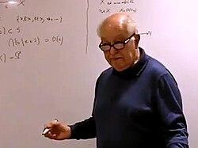
Introduction
Born in 1967 by Jean Bénabou - in Category Theory
Programming with Effects – Eugenio Moggi
Contributions in Haskell – Philip Wadler
Fig1. Jean Bénabou (1932-2022), Jean Bénabou, “Fibered categories and the foundations of naïve category theory”^{[2]}
3

Slide 4

Example (Coq)
{
Expr
Inductive expr : Type :=
| Val : nat -> expr
| Div : expr -> expr -> expr.
Option
Fig2. Eugenio Moggi, Moggi, Eugenio (1991). “Notions of Computation and Monads”^{[2]}
Inductive option (A : Type) : Type :=
| Some : A -> option A
| None : option A.
}
4

Slide 5
Example (Cont.)
{
Fixpoint eval_no_monad (e : expr) : option nat :=
match e with
| Val n => Some n
| Div e1 e2 =>
match eval_no_monad e1 with
| Some n1 =>
match eval_no_monad e2 with
| Some n2 =>
if n2 =? 0 then None else Some (n1 / n2)
| None => None
end
| None => None
end
end.
}
5

Slide 6
Idea of Monads
{
Definition ret {A : Type} (x : A) : option A := Some x.
Definition bind {A B : Type} (oa : option A) (f : A -> option B) : option B :=
match oa with
| Some a => f a
| None => None
end.
}
6

Slide 7
Monad in Coq
{
Fixpoint eval (e : expr) : option nat :=
match e with
| Val n => ret n
| Div e1 e2 =>
bind (eval e1) (fun n1 =>
bind (eval e2) (fun n2 =>
if n2 =? 0 then None else ret (n1 / n2)))
end.
}
7

Slide 8
Monad in Coq (Cont.)
{
Class Monad@{d c} (T : Type@{d} -> Type@{c}) : Type :=
{
ret : forall {A : Type@{d}}, A -> T A ;
bind : forall {A B : Type@{d}}, T A -> (A -> T B) -> T B
}.
}
8

Slide 9
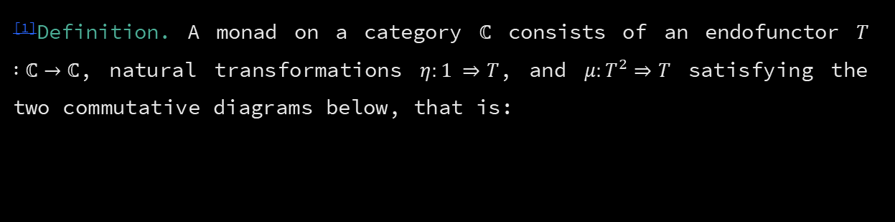
Monads - Category Theory
^{[1]}Definition. A monad on a category ℂ consists of an endofunctor $T :\text{ℂ}→\text{ℂ}$, natural transformations $η:1 ⇒T$, and $μ:T^{2}⇒T$ satisfying the two commutative diagrams below, that is:
$$μ∘μ_{T}=μ∘Tμ$$
𝜇∘𝜇_𝑇=𝜇∘𝑇𝜇
$μ∘η_{T}=1=μ∘Tη$
𝜇∘𝜂_𝑇=1=𝜇∘𝑇𝜂
9

Slide 10

Coproduct
^{[1]}Definition. $(Q, q_{1}:A→Q,q_{2}:B→Q)$is a coproduct of $A$and $B$, if
$$∀ \left(Z, z_{1}:A→Z , z_{2}:B→Z\right) ∃!u:Q→Z$$
$$s.t. u∘q_{i}=z_{i}, i=1, 2$$
Coproduct in Sets: Disjoint Union
Coproduct Diagram
10

Slide 11
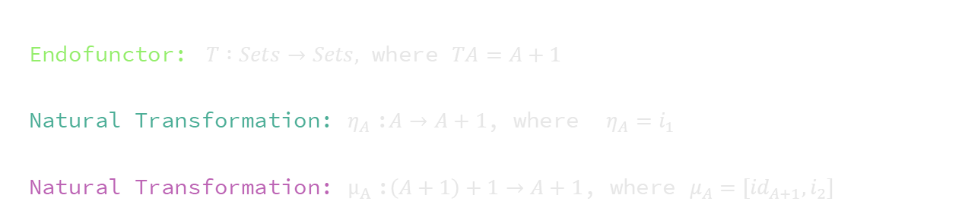
Example
Endofunctor: $T :Sets→Sets,$ where $TA=A+1$
Natural Transformation: $η_{A}$:$A→A+1$, where $η_{A}=i_{1}$
Natural Transformation: $μ_{A}$:$\left(A+1\right)+1→A+1$, where $μ_{A}=[{id}_{A+1}, i_{2}]$
11

Slide 12
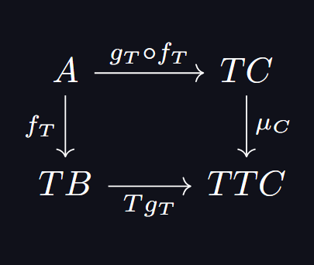

Kleisli Category
^{[3]}Definition. For any monad $M$=<$T, η, μ$> on ℂ, the Kleisli Category $Kl(M)$ is defined as follows:
Objects: $A_{T}, B_{T}, …$
Morphisms: $f:A→TB$ $∈$ $ℂ_{1}$
$id\left(A_{T}\right) : η_{A}:A →TA$
Composition: For $f_{T}:A_{T}→B_{T}$ and $g_{T}:B_{T}→C_{T}$:
12

Slide 13
Connection
Monads
$M=($_+1,$η, μ)$
𝑀=(_+1,𝜂, 𝜇)
Interpretation of Option
Interpretation of $T$
Interpretation of 𝑇
12

Slide 14
References
Awodey, Steve. “Category Thoery”. 2nd ed., Oxford University Press, 2010
All portraits and personal images in this presentation are taken from publicly available content on Wikipedia pages of the respective individuals.
13

Slide 15
Thank you

